Slide 1

Stock Prediction
GROUP MEMBERS:
M.Ajay kumar-2403A52378
L.Manogna -2403A52388
G.Sanjana-2403A52380
Stock Price Prediction Using Machine Learning

Slide 2

Introduction
This presentation explores how machine learning can be leveraged to predict stock prices. We will cover the basics of stock price prediction, key algorithms used, and methodologies for building effective predictive models. Understanding these concepts enables better decision-making in financial markets through data-driven insights and advanced analytical techniques.

Slide 3

Machine Learning for Stock Price Prediction
Machine Learning (ML) is widely used in financial markets to analyze historical stock data and predict future price movements. The goal is to identify patterns, trends, and relationships that are not easily visible through traditional methods.

Slide 4

Fundamentals of Stock Price Prediction
Stock price prediction involves forecasting future market prices based on historical data and various influencing factors. Key components include analyzing trends, market sentiment, and economic indicators. Accurate prediction relies on data quality, feature selection, and understanding market volatility to capture complex patterns dynamically.

Slide 5
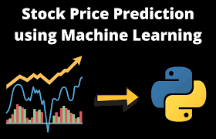
Key Machine Learning Algorithms
Popular algorithms for stock prediction include linear regression, random forests, and recurrent neural networks (RNNs). Each offers strengths in modeling different data patterns, from linear to complex temporal sequences. Selecting the right algorithm depends on the data characteristics and the specific prediction objectives.

Slide 6

Data Sources and Feature Engineering
Effective stock price prediction depends on robust data collection from sources such as historical prices, financial statements, and market news. Feature engineering transforms raw data into meaningful inputs, extracting metrics like moving averages and volatility indicators. This process enhances model accuracy by highlighting critical patterns and relationships within complex financial datasets.

Slide 7

Building a Stock Price Prediction Assistant
Building a stock price prediction assistant involves developing a system that can analyze past market data and forecast future stock movements. The process begins with collecting high-quality historical price data, technical indicators, and relevant market information. This data is then preprocessed, normalized, and converted into meaningful features for machine learning models.

Slide 8
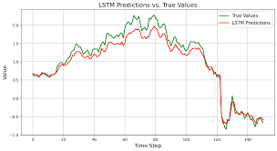
Model Training and Evaluation
Training involves feeding historical data into the model to learn patterns and relationships. Evaluation metrics like mean squared error (MSE) and accuracy assess prediction quality. Cross-validation and hyperparameter tuning optimize performance, ensuring the model generalizes well to unseen data, which is crucial for reliable stock price forecasting.

Slide 9

Deployment and User Interaction
Deploying the model as an assistant allows real-time stock price predictions accessible to users through intuitive interfaces. Integration with platforms enables seamless data updates and alerts. User interaction focuses on providing actionable insights, visual analytics, and customization options to support informed investment decisions.

Slide 10
Challenges and Future Enhancements
Building a stock price prediction system comes with several challenges, mainly due to the highly volatile and unpredictable nature of financial markets. Sudden economic changes, unexpected news, and market sentiment can significantly affect prediction accuracy. Data quality issues, such as missing values, noise, and inconsistent formats, further complicate the modeling process. Overfitting is also a common concern, as models may perform well on historical data but fail in real-world scenarios. For future enhancements, integrating news sentiment analysis, social media trends, and real-time data streams can improve prediction reliability. More advanced deep learning models like Transformers, hybrid architectures, or reinforcement learning can be applied to capture complex market behavior. Additionally, deploying the system as an interactive assistant with visualization dashboards and continuous model retraining can make the solution more reliable, scalable, and user-friendly.

Slide 11
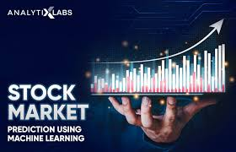
Conclusions
Machine learning offers powerful tools for stock price prediction by uncovering complex market patterns. Success depends on quality data, appropriate algorithms, and continuous model refinement. Deploying predictive assistants provides valuable decision-making support, with ongoing innovation necessary to address market challenges and enhance forecasting reliability.

Slide 12


THANK YOU

